Slide 1
Quantitative Analysis of Competitive Harmony between Direct and Indirect Pathways in A Spiking Neural Network of Basal Ganglia
S.-Y. Kim and W. Lim
Institute for Computational Neuroscience
Daegu National University of Education
• Basal Ganglia (BG)
A group of subcortical deep-lying nuclei (“dark basement” of the brain)
- A variety of functions for motor and cognition
Control of voluntary movement and important roles in cognitive processes
(e.g., action selection, motor planning)
• Parkinson’s Disease (PD)
- Dysfunction of BG (neurodegenerative disease):
Motor deficits such as slowed movement (bradykinesia), rigidity, and tremor
Cognitive deficit: dementia
• Purpose of Our Study
Quantitative analysis of competitive harmony between direct and indirect
pathways by using competition degree for the healthy and Parkinsonian states
1

Slide 2
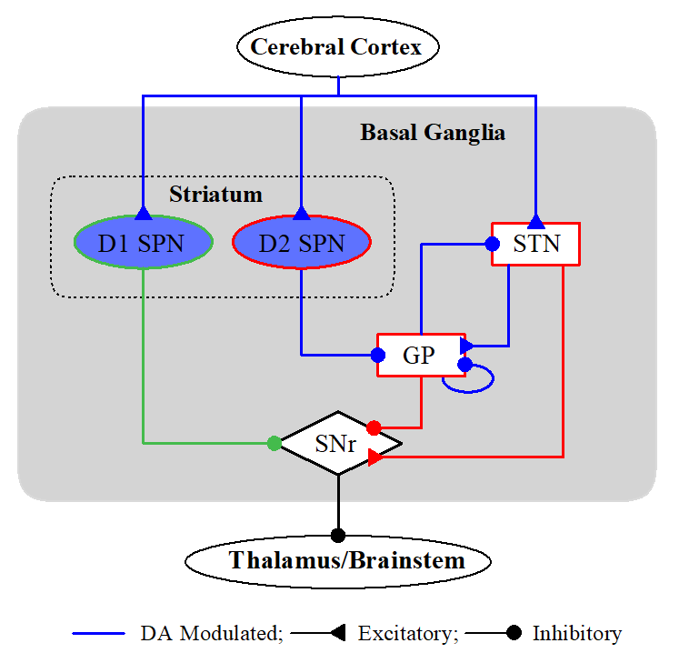
Spiking Neural Network (SNN) of The BG
BG: a collection of subcortical nuclei
[DA (dopamine) modulated: green color]
• Input Nuclei
- Striatum (principal input to the BG)
spiny projection neurons (SPNs)
with D1/D2 receptors for the DA
- STN (subthalamic nucleus)
only excitatory nucleus in the BG
• Output Nuclei
- SNr (substantia nigra pars reticulate)
• Intermediate Control Nucleus
- GP (globus pallidus external segment)
D1 SPNs project inhibition directly to the output nuclei SNr via the direct (“GO”) pathway (DP). On the other hand, D2 SPNs are connected to the SNr via the indirect (“No-GO”) pathway (IP) crossing the GP and the STN.
BG: modulating and gating action selection via balance between the Go and No-Go
pathways → action selection device (gearbox in an auto)
2

Slide 3
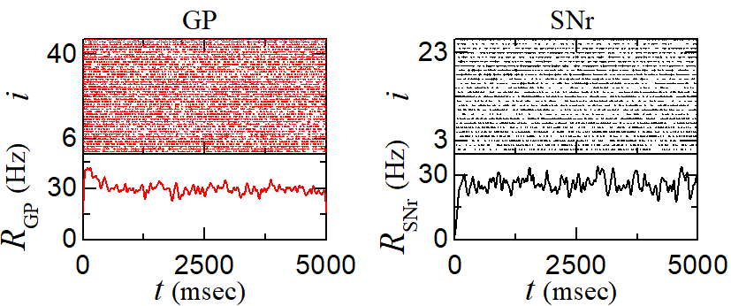
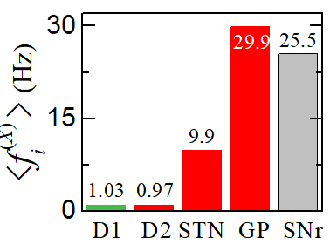
Default State for The Tonic Cortical Input in The Resting State
• Population and Individual
Behaviors of BG Cells for Tonic
Cortical Input
- Tonic cortical input: $f_{Ctx}=3 Hz$
→ Resting state
- Normal DA level: $φ=0.3$
D1 & D2 SPNs: nearly silent
Output SNr cells: very active
→ Leading to no movement
• Strengths of DP and IP Currents
- DP current: $I_{DP}=−I_{syn}^{\left(SNr,D1\right)}=−23.1 pA$
- IP current: $I_{IP}=I_{IP}^{(E)}+I_{IP}^{(I)}$; $I_{IP}^{(E)}=−I_{syn}^{\left(SNr,STN\right)}$ & $I_{IP}^{(I)}=−I_{syn}^{\left(SNr,GP\right)}$ $I_{IP}=23.4 pA$
- Strengths of DP & IP Currents: $𝒮_{DP}=\left|\overline{I_{DP}}\right|$ & $𝒮_{IP}=\left|\overline{I_{IP}}\right|$
• Competition Degree
$𝒞_{d}=𝒮_{DP}/𝒮_{IP}$=0.99
DP & IP: balanced → SNr: fire actively
→ Thalamic cells: silent
→ No movement
3

Slide 4
Activation of Direct and Indirect Pathways
• Activation and Deactivation of Target Cells Using Optogenetic Technique
- Fusion of the opsins (light-sensitive proteins) into the target cells & Activation of opsins
by specific wavelengths of light → Variation of intrinsic ionic current $ΔI_{ion}^{(X)}$
• Activation of DP: $ΔI_{ion}^{(D1)}=120 pA$
- Increase in activity of D1 SPNs
→ Suppressing of SNr activity
→ Increase in $𝒞_{d}$ & Facilitating
movement
• Activation of IP: $ΔI_{ion}^{(D2)}=150 pA$
- Increase in activity of D2 SPNs
→ Suppressing of GP activity &
Enhancing of STN
→ More activity of SNr
→ Decrease in $𝒞_{d}$ & Suppressing
movement
• Competition between DP & IP
With increasing $ΔI_{ion}^{(D2)}$ for $ΔI_{ion}^{(D1)}=120$
→ Increasing strength of IP → Decrease in $𝒞_{d}$ → Increase in SNr activity
$ΔI_{ion}^{(D2)}<ΔI_{ion}^{\left(D2\right)∗}$: $𝒞_{d}>1$ → DP>IP → Facilitating movement
$ΔI_{ion}^{(D2)}>ΔI_{ion}^{\left(D2\right)∗}$: $𝒞_{d}<1$ → DP<IP → Suppressing movement
4

Slide 5
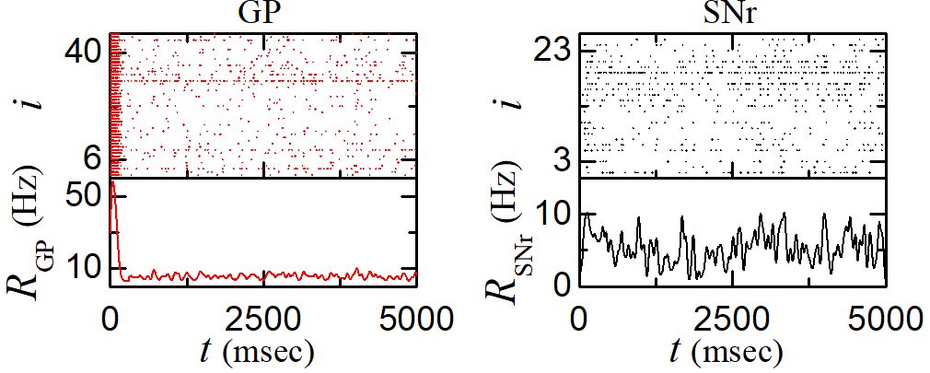
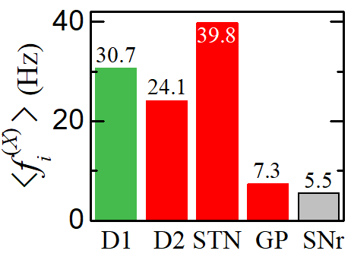
Healthy State for The Phasic Cortical Input
• Population and Individual
Behaviors of BG Cells for Phasic
Cortical Input
- Cortical input: $f_{Ctx}=10 Hz$
- Normal DA level: $φ=0.3$
→ Healthy Phasically-active state
D1 & D2 SPNs: Active
→ Increase in activity of STN
& decrease in activity of GP
Output SNr cells: Decreased activity
→ Facilitating movement
• Strengths of DP & IP Currents and Competition Degree
- Increase in Strengths of DP & IP currents: $𝒮_{DP}=2309.7$ & $𝒮_{IP}=815.6$
$𝒮_{DP}$ is much more increased than $𝒮_{IP}$
→ Increase in $𝒞_{d}=2.82$
- BG gate to the thalamus becomes
opened
→ Facilitating movement
5

Slide 6
Pathological State for The Phasic Cortical Input
• Pathological State
- Reduced DA level: $φ=φ^{∗}(=0.3)x_{DA}$ with phasic cortical input: $f_{Ctx}=10 Hz$
- With decreasing DA level, Decrease in activity of D1 SPN → Under-active DP
Increase in activity of D2 SPN → Over-active IP
• Strengths of DP & IP Currents and Competition Degree
- With decreasing DA level, little decrease in $𝒮_{DP}$ & increase in $𝒮_{IP}$ → Decrease in $𝒞_{d}$
- Increase in activity of SNr; For $x_{DA}<x_{DA}^{∗} (≃0.27)$, $𝒞_{d}<1$ → No movement
6

Slide 7
Treatment of Pathological States
• Strengthening DP via Activation of D1 SPN
For $x_{DA}=0.6$, Strengthened DP → Increase in $𝒞_{d}$
$ΔI_{ion}^{\left(D1\right)∗}=51 pA$ → $𝒞_{d}=𝒞_{d}^{∗}$ (=2.82 for healthy state)
→ Harmony between DP & IP is recovered
As $x_{DA}$ is decreased, increase in $ΔI_{ion}^{\left(D1\right)∗}$
→ More $ΔI_{ion}^{\left(D1\right)∗}$ is necessary for recovery of harmony between DP & IP
• Weakening IP via Deactivation of D2 SPN
For $x_{DA}=0.6$, Weakened IP → Increase in $𝒞_{d}$
$ΔI_{ion}^{\left(D2\right)∗}=−65 pA$ → $𝒞_{d}=𝒞_{d}^{∗}$ → Harmony between DP & IP is recovered
As $x_{DA}$ is decreased, decrease in $ΔI_{ion}^{\left(D2\right)∗}$
→ More negative $ΔI_{ion}^{\left(D2\right)∗}$ is necessary for recovery of harmony between DP & IP
7

Slide 8
Treatment of Pathological States - Continued
• Weakening IP via Deactivation of STN
For $x_{DA}=0.6$, Weakened IP → Increase in $𝒞_{d}$
$ΔI_{ion}^{\left(STN\right)∗}=−42 pA$ → $𝒞_{d}=𝒞_{d}^{∗}$ → Harmony between DP & IP is recovered
As $x_{DA}$ is decreased, decrease in $ΔI_{ion}^{\left(STN\right)∗}$
→ More negative $ΔI_{ion}^{\left(STN\right)∗}$ is necessary for recovery of harmony between DP & IP
• Weakening IP via Ablation of STN
For $x_{DA}=0.6$, Weakened IP → Increase in $𝒞_{d}$
$x_{STN}^{∗}≃0.51$ → $𝒞_{d}=𝒞_{d}^{∗}$ → Harmony between DP & IP is recovered
As $x_{DA}$ is decreased, decrease in $x_{STN}^{∗}$
→ More ablation (smaller $x_{STN}$) is necessary for recovery of harmony between DP & IP
8

Slide 9
Summary
• Basal Ganglia (BG)
- A group of subcortical nuclei exhibiting a diverse of functions for motor and cognition
- Parkinson’s disease: motor and cognition deficits
• Quantifying Competitive Harmony between “Go” Direct Pathway (DP) and “No-Go” Indirect Pathway (IP)
- Competition degree $𝒞_{d}(=𝒮_{DP}/𝒮_{IP})$: Ratio of strength of DP ($𝒮_{DP}$) to strength of IP ($𝒮_{IP}$)
- Default BG state: $𝒞_{d}≃1$→ DP and IP are nearly balanced
→ Locked state of BG gate to the thalamus → No voluntary movement
- Phasically-active healthy state: $𝒞_{d}=2.82$→ DP is 2.82 times stronger than IP
→ Opened state of BG gate to the thalamus → Normal movement
• Pathological State and Treatment
- Pathological state: Reduced DA level
Decrease in activity of D1 SPN → Under-active DP
Increase in activity of D2 SPN → Over-active IP
- Treatment of pathological state
Strengthening DP via Activation of D1 SPN
Weakening IP via Deactivation of D2 SPN & STN or Ablation of STN
→ Increase in $𝒞_{d}$ → Harmony between DP & IP is recovered
9

