Slide 1
Effect of Adult-Born Immature Granule Cells on Pattern Separation in A Biological Network of The Hippocampal Dentate Gyrus
S.-Y. Kim and W. Lim
Institute for Computational Neuroscience
Daegu National University of Education
• Hippocampus
- Consisting of the dentate gyrus (DG) and the areas CA3 and CA1
- Play a key role in memory formation, storage, and retrieval
• Pattern Separation
- Pattern Separation: Transforming input patterns into sparser and orthogonalized patterns
- DG: Pre-processor for the CA3: Granule cells (GCs) in the DG performs pattern separation,
facilitating pattern storage and retrieval in the CA3
- Sparsity → Enhancing the pattern separation
• Young Adult-Born Immature Granule Cells (imGCs)
- Young adult-born imGCs: High excitability (causing high activation) and low excitatory
innervation (reducing activation)
• Purpose of Our Study
Investigation of Adult-Born Immature Granule Cells on Pattern Separation in The
Hippocampal Dentate Gyrus
1

Slide 2
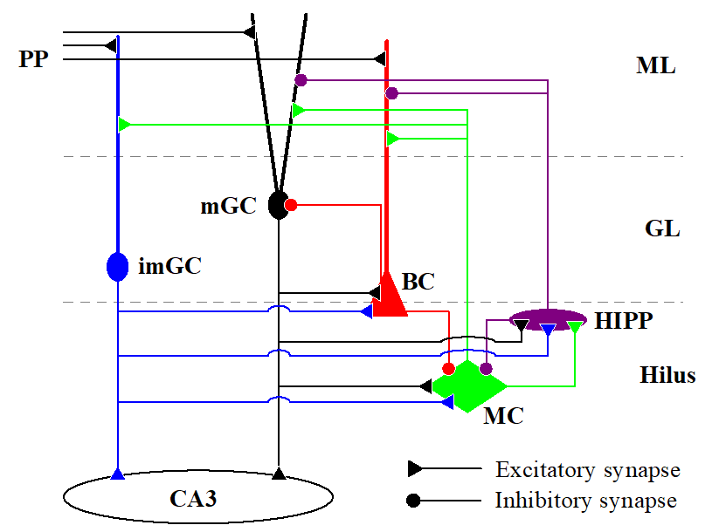
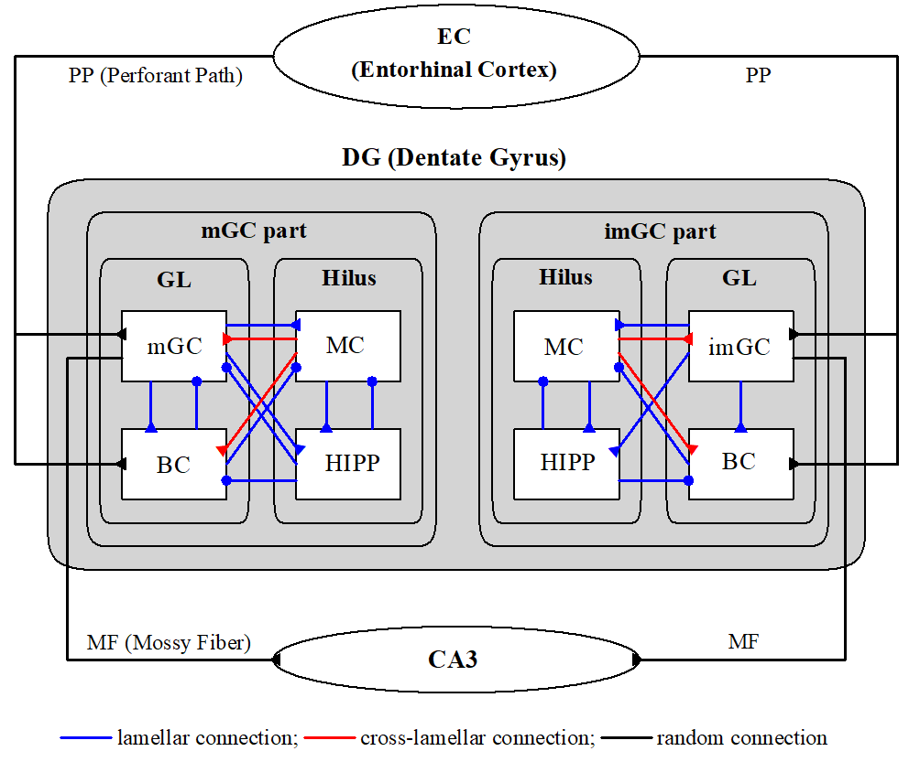
Hippocampal Dentate Gyrus (DG) Network
• Cells in The DG Network
- DG receives inputs from the entorhinal cortex (EC) via
the perforant paths (PPs)
- Granular Layer: Excitatory granule cells (GCs): providing
the output to the CA3 via the mossy fibers (MFs) &
Inhibitory basket cells (BCs)
- Hilus: Excitatory mossy cells (MCs) & Inhibitory hilar
perforant path-associated (HIPP) cells
• Architecture of The DG Network
- EC Network 𝑁_{𝐸𝐶} (=400) EC cells
- Granular-layer Network: 𝑁_{𝐶} (=20) GC clusters
𝑁_{𝐺𝐶} (=100) GCs & one BC in each GC cluster
→ Total No. of GCs = 2000 & No. of BCs = 20
Fraction of imGCs = 10 %
10 imGCs in each GC cluster
→ Total No. of imGCs (mGCs) = 200 (1800)
- Hilus Ring Network: 𝑁_{𝑀𝐶} (=60) MCs & 𝑁_{𝐻𝐼𝑃𝑃} (=20)
HIPP cells; MCs & HIPP cells are also grouped into
20 GC clusters
• Firing Transitions of Adult-Born imGCs
- mGC with leakage reversal potential 𝑉_{𝐿}=−75 mV
→ Threshold for the firing transition: 𝐼∗=80 pA
- imGC with 𝑉_{𝐿}=−72 mV → 𝐼∗=69.7 pA
→ Lower firing threshold → High excitability
2

Slide 3
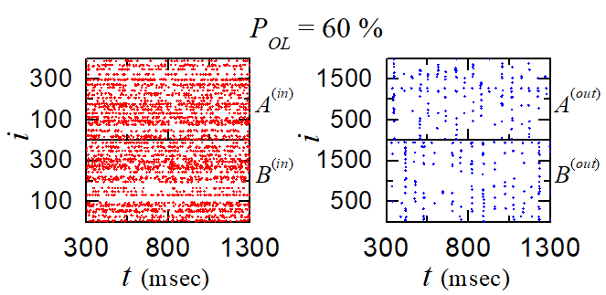
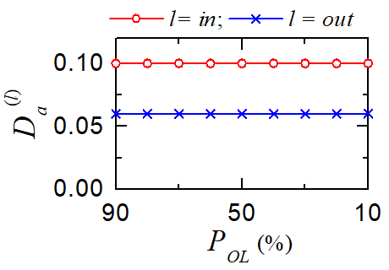
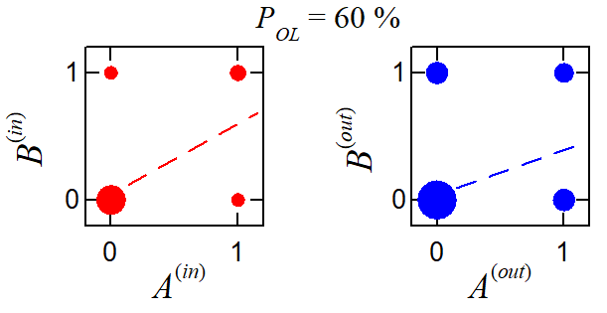
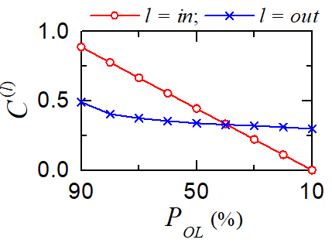
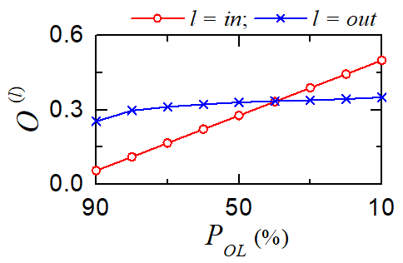
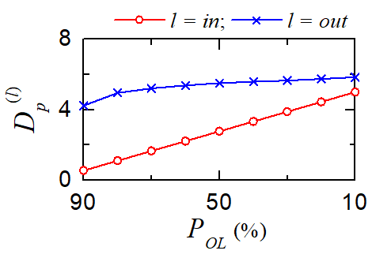
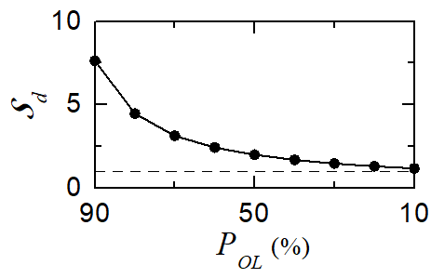
Pattern Separation in The Presence Only The mGCs without imGCs
• Binary Representation of Spiking Activity of EC Cells
- Active EC cells: at least one spike during the stimulus stage (1) otherwise, silent EC cells (0)
- 𝐴^{(𝑖𝑛)} : Randomly-chosen input pattern & Construct another input patterns $B_{i}^{(in)}$from the with
the overlap percentage 𝑃_{𝑂𝐿}
• Binary Representation of Spiking Activity of GCs
- Active GCs: at least one spike during the stimulus stage (1) otherwise, silent GCs (0)
• Characterization of Pattern Separation
- Activation Degrees
GCs: More sparse firings than EC cells
$D_{a}^{\left(in\right)}$(=0.1) > $D_{a}^{\left(out\right)}$(=0.06)
- Pattern Correlation Degree $C^{(l)}=ρ^{\left(l\right)}$($l=in or out$)
Pearson’s correlation coefficient $ρ^{\left(l\right)}$: denoting
similarity degree between two patterns
- Orthogonalization degree 𝑂^{(𝑥)}=(1−𝜌^{(𝑥)})/2; 𝑥=𝑖𝑛, 𝑜𝑢𝑡
representing dissimilarity degree between
two patterns
𝑃_{𝑂𝐿}≥40% → 𝑂^{(𝑜𝑢𝑡)}>𝑂^{(𝑖𝑛)}, 𝑃_{𝑂𝐿}<40% → 𝑂^{(𝑖𝑛)}>𝑂^{(𝑜𝑢𝑡)}
- Pattern Distance: $𝒟_{p}^{(x)}=O^{(x)}/D_{a}^{(x)}$
- Pattern Separation Degree
$𝒮_{d}=𝒟_{p}^{\left(out\right)}/𝒟_{p}^{\left(in\right)}$
𝒮_{𝑑}>1 for all values of 𝑃_{𝑂𝐿}
→ Pattern separation occurs
3

Slide 4
Effect of Adult-born imGCs on the Pattern Separation
• Low Excitatory Innervation of imGCs
- Connection probability 𝑝_{𝑐} from the EC cells and the MCs to the mGCs = 20 %
- imGCs: 𝑝_{𝑐} is decreased to 20 𝑥 % [𝑥 (synaptic connectivity fraction); 0 ≤ 𝑥 ≤ 1]
• Effect of Low Excitatory Innervation for The imGCs
- Pattern Integration by imGCs: With decreasing 𝑥 from 1, the imGCs receive
low excitatory drive from the EC cells and the MCs
→ $D_{a}^{\left(im\right)}$ of the imGCs decreases so rapidly.
→ Effect of imGCs becomes weaker; 𝐶^{(𝑖𝑚)} of the imGCs are very high
→ imGCs: good pattern integrators with the pattern
integration degree ℐ_{𝑑} [=𝐶^{(𝑖𝑚)}/𝐶^{(𝑖𝑛)}] >1
- Pattern Separation by mGCs: With decreasing 𝑥 from 1,
the feedback inhibition to the mGCs is decreased due
to decrease $D_{a}^{\left(im\right)}$ → Increase in $D_{a}^{\left(m\right)}$
→ Decrease in pattern separation efficacy $𝒮_{d}^{(m)}$
- Pattern Separation Efficacy of The mGCs
$𝒮_{d}^{(m)}$ varies by competition between high excitability
and low excitatory innervation of the imGCs
Effect of high excitability > Effect of low excitatory
[1≥𝑥>𝑥∗ (≃0.4)] → Pattern separation efficacy of the mGCs: Enhanced
Effect of low excitatory innervation > Effect of high excitability
(𝑥>𝑥∗≥0) → Pattern separation efficacy of the mGCs: Worsened
4

Slide 5
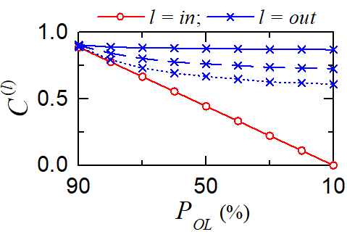
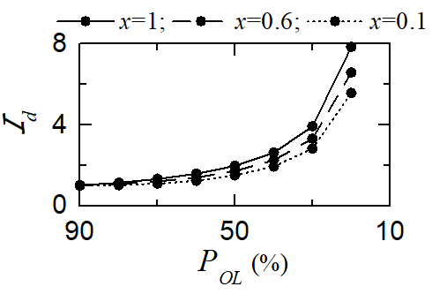
Pattern Integration in The Presence of Only imGCs
• Pattern Correlation Degree
𝐶^{(𝑖𝑚)}>𝐶^{(𝑖𝑛)} for all range of 𝑃_{𝑂𝐿}
• Pattern Integration Efficacy of The imGCs
- Pattern integration efficacy of the imGCs:
Better for dissimilar input patterns
Worse for similar input patterns
cf. Pattern separation of the mGCs
better for similar input patterns
5

Slide 6
Summary
• Investigation of Effect of The Young Adult-Born imGCs on Pattern Separation
- In contrast to the mature GCs (mGCs), the imGCs exhibit two competing distinct properties of high
excitability (causing high activation) and low excitatory innervation (reducing activation degree)
- The pattern separation efficacy the mGCs varies via competition between high excitability
and low excitatory innervation of the imGCs
State I (0≤𝑥<𝑥∗) with lower synaptic maturity:
Effect of the effect of low excitatory innervation
to the imGCs > Effect of high excitability
→ Activation degree $D_{a}^{\left(im\right)}$ of the imGCs becomes
lower.
→ Reduction of inhibition to the mGCs (imGC → BC/HPP → mGC)
→ Increase in $D_{a}^{\left(m\right)}$ of the mGCs → Pattern separation degree $𝒮_{d}^{(m)}$<𝒮∗
(𝒮∗: in the presence of only mGCs without imGCs)
→ Worsened pattern separation efficacy
State II (𝑥∗<𝑥≤1) with higher synaptic maturity:
Effect of high excitability > Effect of the effect of low excitatory innervation
→ Activation degree $D_{a}^{\left(im\right)}$ of the imGCs becomes higher.
→ Strong feedback inhibition to the mGCs
→ Lower $D_{a}^{\left(m\right)}$ of the mGCs → Pattern separation degree $𝒮_{d}^{(m)}$>𝒮∗
→ Enhanced pattern separation efficacy
6

