Slide 1
Break-up and Recovery of Harmony between Direct and Indirect Pathways in A Spiking Neural Network of The Basal Ganglia
S.-Y. Kim and W. Lim
Institute for Computational Neuroscience
Daegu National University of Education
• Basal Ganglia (BG)
A group of subcortical deep-lying nuclei (“dark basement” of the brain)
- A variety of functions for motor and cognition
Control of voluntary movement and important roles in cognitive processes
(e.g., action selection, motor planning)
• Huntington’s Disease (HD)
- Dysfunction of BG (neurodegenerative disease) with severe symptoms for
motor, cognition, and emotion
- Two Types of spine projection neurons (SPNs) with D1 and D2 receptors for the
Dopamine (DA)
- In the early stage of HD, degenerative loss of D2 SPNs occurs due to mutation in the
huntingtin (HTT) gene, while DA level in the striatum is nearly normal.
• Purpose of Our Study
Quantitative analysis of break-up and recovery of harmony between direct and
indirect pathways by using competition degree for the healthy and pathological
states
1

Slide 2
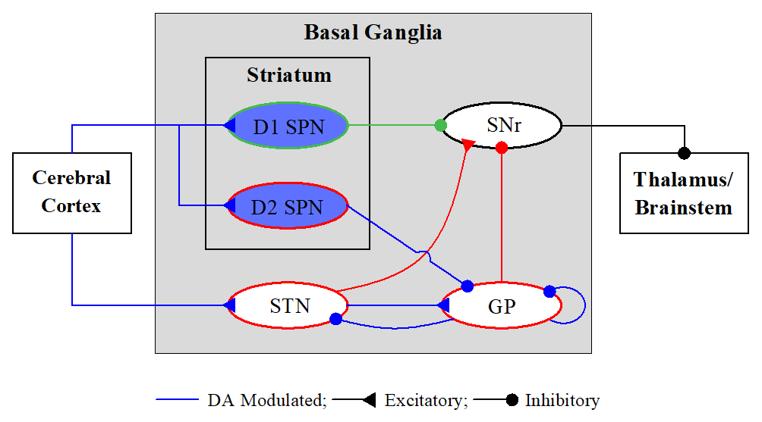
Spiking Neural Network (SNN) of The BG
BG: a collection of subcortical nuclei
[DA modulated: green color]
• Input Nuclei
- Striatum (principal input to the BG)
spiny projection neurons (SPNs)
with D1/D2 receptors for the DA
- STN (subthalamic nucleus)
only excitatory nucleus in the BG
• Output Nuclei
- SNr (substantia nigra pars reticulate)
• Intermediate Control Nucleus
- GP (globus pallidus external segment)
D1 SPNs project inhibition directly to the output nuclei SNr via the direct (“GO”) pathway (DP). On the other hand, D2 SPNs are connected to the SNr via the indirect (“No-GO”) pathway (IP) crossing the GP and the STN.
BG: modulating and gating action selection via balance between the Go and No-Go
pathways → action selection device (gearbox in an auto)
2

Slide 3
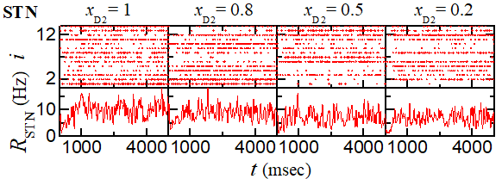
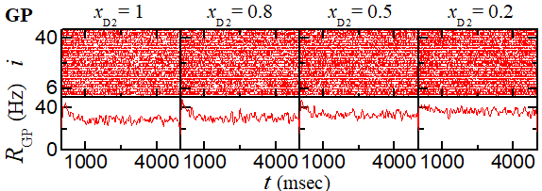
Involuntary Jerky Movement Due to Degenerative Loss of
D2 SPNs in Tonic Pathological State
• Tonic Pathological State with Tonic Cortical Input $f_{Ctx}=3 Hz \text{for} φ=0.3$
- With decreasing fraction of number of D2 SPNs $x_{D2} (1>x_{D2}≥0$),
Decrease in increase in activity of GP and decrease in activity of STN → Under-active IP
3

Slide 4
Involuntary Jerky Movement Due to Degenerative Loss of
D2 SPNs in Tonic Pathological State - Continued
• Strengths of DP & IP Currents and Competition Degree
- With decreasing fraction of number of D2 SPNs,
Decrease in $𝒮_{IP}$ → Increase in $𝒞_{d}$ (=$𝒮_{DP}/𝒮_{IP}$)
- Decrease in activity of SNr
- Appearance of pathological states (where harmony between DP and IP is broken up)
due to degenerative loss of D2 SPNs
4

Slide 5
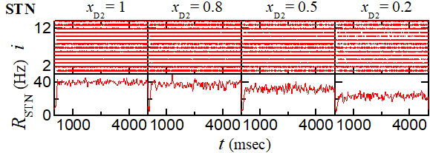
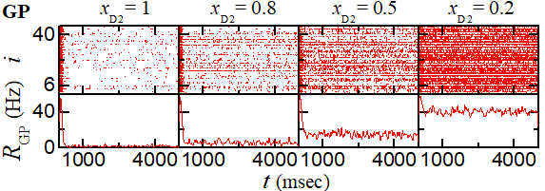
Abnormal Hyperkinetic Movement Due to Degenerative Loss of D2 SPNs in Phasic Pathological State
• Phasic Pathological State with Phasic Cortical Input $f_{Ctx}=10 Hz \text{for} φ=0.3$
- With decreasing fraction of number of D2 SPNs $x_{D2} (1>x_{D2}≥0$),
Decrease in increase in activity of GP and decrease in activity of STN → Under-active IP
5

Slide 6
Abnormal Hyperkinetic Movement Due to Degenerative Loss of D2 SPNs in Phasic Pathological State - Continued
• Strengths of DP & IP Currents and Competition Degree
- With decreasing fraction of number of D2 SPNs,
Decrease in $𝒮_{IP}$ → Increase in $𝒞_{d}$
- Decrease in activity of SNr
- Appearance of pathological states (where harmony between DP and IP is broken up)
due to degenerative loss of D2SPNs
6

Slide 7
Treatment of Tonic Pathological State by Strengthening IP
• Strengthening IP via Activation of D2 SPN via Optogenetics
For $x_{D2}=0.5$, Strengthened IP → Decrease in $𝒞_{d}$
$ΔI_{ion}^{\left(D2\right)∗}=262 pA$ → $𝒞_{d}=𝒞_{d}^{∗}$ (=1 for tonic healthy state)
→ Harmony between DP & IP is recovered
As $x_{D2}$ is decreased, increase in $ΔI_{ion}^{\left(D2\right)∗}$
→ More $ΔI_{ion}^{\left(D2\right)∗}$ is necessary for recovery of harmony between DP & IP
• Strengthening IP via Activation of STN via Optogenetics
For $x_{D2}=0.5$, Strengthened IP → Decrease in $𝒞_{d}$
$ΔI_{ion}^{\left(STN\right)∗}=14 pA$ → $𝒞_{d}=𝒞_{d}^{∗}$ → Harmony between DP & IP is recovered
As $x_{D2}$ is decreased, increase in $ΔI_{ion}^{\left(STN\right)∗}$
→ More $ΔI_{ion}^{\left(STN\right)∗}$ is necessary for recovery of harmony between DP & IP
7

Slide 8
Treatment of Tonic Pathological State by Strengthening IP
• Strengthening IP via Deactivation of GP via Optogenetics
For $x_{D2}=0.5$, Strengthened IP → Decrease in $𝒞_{d}$
$ΔI_{ion}^{\left(GP\right)∗}=−28 pA$ → $𝒞_{d}=𝒞_{d}^{∗}$ → Harmony between DP & IP is recovered
As $x_{D2}$ is decreased, decrease in $ΔI_{ion}^{\left(GP\right)∗}$
→ More negative $ΔI_{ion}^{\left(GP\right)∗}$ is necessary for recovery of harmony between DP & IP
• Strengthening IP via Ablation of GP
For $x_{D2}=0.5$, Strengthened IP → Decrease in $𝒞_{d}$
${ x}_{GP}^{∗}≃0.78$ → $𝒞_{d}=𝒞_{d}^{∗}$ → Harmony between DP & IP is recovered
As $x_{D2}$ is decreased, decrease in $x_{GP}^{∗}$
→ More ablation (smaller $x_{GP}$) is necessary for recovery of harmony between DP & IP
8

Slide 9
Treatment of Phasic Pathological State by Strengthening IP
• Strengthening IP via Activation of D2 SPN via Optogenetics
For $x_{D2}=0.5$, Strengthened IP → Decrease in $𝒞_{d}$
$ΔI_{ion}^{\left(D2\right)∗}=1,636 pA$ → $𝒞_{d}=𝒞_{d}^{∗}$ (=2.82 for phasic healthy state)
→ Harmony between DP & IP is recovered
As $x_{D2}$ is decreased, increase in $ΔI_{ion}^{\left(D2\right)∗}$
→ More $ΔI_{ion}^{\left(D2\right)∗}$ is necessary for recovery of harmony between DP & IP
• Strengthening IP via Activation of STN via Optogenetics
For $x_{D2}=0.5$, Strengthened IP → Decrease in $𝒞_{d}$
$ΔI_{ion}^{\left(STN\right)∗}=405 pA$ → $𝒞_{d}=𝒞_{d}^{∗}$ → Harmony between DP & IP is recovered
As $x_{D2}$ is decreased, increase in $ΔI_{ion}^{\left(STN\right)∗}$
→ More $ΔI_{ion}^{\left(STN\right)∗}$ is necessary for recovery of harmony between DP & IP
9

Slide 10
Treatment of Phasic Pathological State by Strengthening IP
• Strengthening IP via Deactivation of GP via Optogenetics
For $x_{D2}=0.5$, Strengthened IP → Decrease in $𝒞_{d}$
$ΔI_{ion}^{\left(GP\right)∗}=−540 pA$ → $𝒞_{d}=𝒞_{d}^{∗}$ → Harmony between DP & IP is recovered
As $x_{D2}$ is decreased, decrease in $ΔI_{ion}^{\left(GP\right)∗}$
→ More negative $ΔI_{ion}^{\left(GP\right)∗}$ is necessary for recovery of harmony between DP & IP
• Strengthening IP via Ablation of GP
For $x_{D2}=0.5$, Strengthened IP → Decrease in $𝒞_{d}$
${ x}_{GP}^{∗}≃0.$52 → $𝒞_{d}=𝒞_{d}^{∗}$ → Harmony between DP & IP is recovered
As $x_{D2}$ is decreased, decrease in $x_{GP}^{∗}$
→ More ablation (smaller $x_{GP}$) is necessary for recovery of harmony between DP & IP
10

Slide 11
Summary
• Basal Ganglia (BG)
- A group of subcortical nuclei exhibiting a diverse of functions for motor and cognition
- Huntington’s disease (HD): motor and cognition deficits
- In the early stage of HD, degenerative loss of D2 SPNs occurs due to mutation in the
huntingtin (HTT) gene, while DA level in the striatum is nearly normal.
• Quantifying Competitive Harmony between “Go” Direct Pathway (DP) and “No-Go” Indirect Pathway (IP)
- Competition degree $𝒞_{d}(=𝒮_{DP}/𝒮_{IP})$: Ratio of strength of DP ($𝒮_{DP}$) to strength of IP ($𝒮_{IP}$)
- Tonic healthy BG state: $𝒞_{d}≃1$→ DP and IP are nearly balanced
→ Locked state of BG gate to the thalamus → No voluntary movement
- Phasically-active healthy state: $𝒞_{d}=2.82$→ DP is 2.82 times stronger than IP
→ Opened state of BG gate to the thalamus → Normal movement
• Pathological State and Treatment
- Pathological state: Decrease in number of D2 SPNs
→ Decrease in increase in activity of GP and decrease in activity of STN → Under-active IP
- Treatment of pathological state
Strengthening IP via Activation of D2 SPN & STN, Deactivation of GP, or Ablation of GP
→ Decrease in $𝒞_{d}$ → Harmony between DP & IP is recovered
11

